Slide 1
Red-Black Trees
David Luebke <number> 11/08/26

Slide 2
Review: Red-Black Trees
Red-black trees:
  Binary search trees augmented with node color
  Operations designed to guarantee that the height
  h = O(lg n)
We described the properties of red-black trees
We proved that these guarantee h = O(lg n)
Next: describe operations on red-black trees
David Luebke <number> 11/08/26

Slide 3
Review: Red-Black Properties
The red-black properties:
  1. Every node is either red or black
  2. Every leaf (NULL pointer) is black
    Note: this means every “real” node has 2 children
  3. If a node is red, both children are black
    Note: can’t have 2 consecutive reds on a path
  4. Every path from node to descendent leaf contains the same number of black nodes
  5. The root is always black
David Luebke <number> 11/08/26

Slide 4
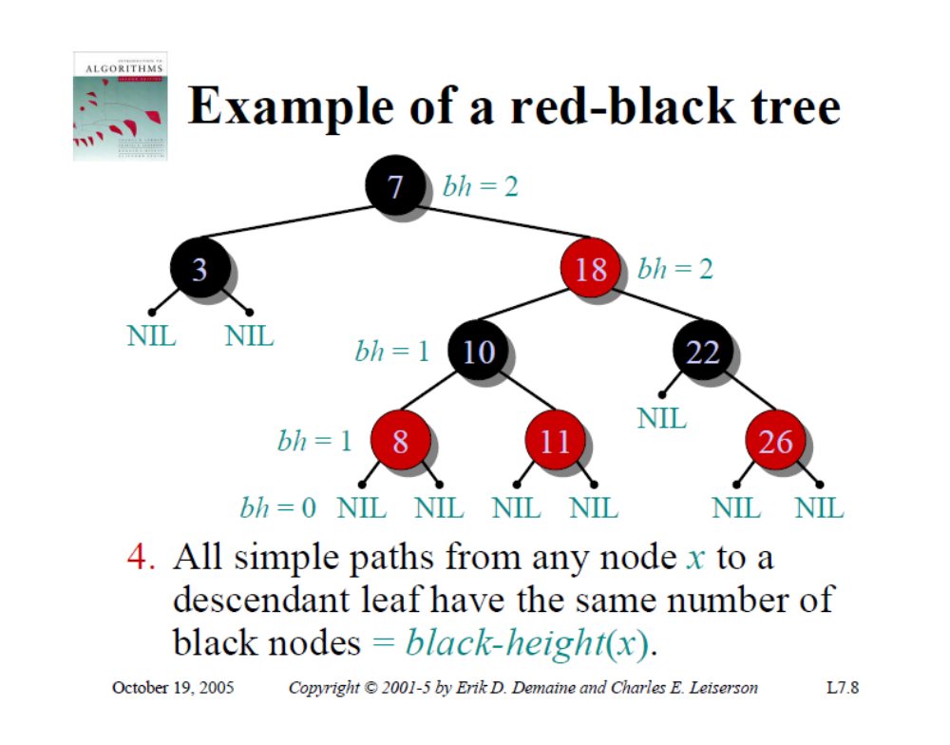

David Luebke <number> 11/08/26

Slide 5
Review: Black-Height
black-height: # black nodes on path to leaf
What is the minimum black-height of a node with height h?
A: a height-h node has black-height ≥ h/2
Theorem: A red-black tree with n internal nodes has height h ≤ 2 lg(n + 1)
  Proved by (what else?) induction
David Luebke <number> 11/08/26

Slide 6
Review: Proving Height Bound
Thus at the root of the red-black tree:
  n ≥ 2^{bh(root)} - 1
  n ≥ 2^{h/2} - 1
  lg(n+1) ≥ h/2
  h ≤ 2 lg(n + 1)
  Thus h = O(lg n)
David Luebke <number> 11/08/26

Slide 7
RB Trees: Worst-Case Time
So we’ve proved that a red-black tree has
O(lg n) height
Corollary: These operations take O(lg n) time:
  Minimum(), Maximum()
  Successor(), Predecessor()
  Search()
Insert() and Delete():
  Will also take O(lg n) time
  But will need special care since they modify tree
David Luebke <number> 11/08/26

Slide 8
Red-Black Trees: An Example
Color this tree:
7
7
5
5
9
9
12
12
Red-black properties:
1. Every node is either red or black
2. Every leaf (NULL pointer) is black
3. If a node is red, both children are black
4. Every path from node to descendent leaf
contains the same number of black nodes
5. The root is always black
David Luebke <number> 11/08/26

Slide 9
Red-Black Trees:
The Problem With Insertion
Insert 8
  Where does it go?
7
5
9
12
1. Every node is either red or black
2. Every leaf (NULL pointer) is black
3. If a node is red, both children are black
4. Every path from node to descendent leaf
contains the same number of black nodes
5. The root is always black
David Luebke <number> 11/08/26

Slide 10
Red-Black Trees:
The Problem With Insertion
Insert 8
  Where does it go?
  What color
  should it be?
7
5
9
8
12
1. Every node is either red or black
2. Every leaf (NULL pointer) is black
3. If a node is red, both children are black
4. Every path from node to descendent leaf
contains the same number of black nodes
5. The root is always black
David Luebke <number> 11/08/26

Slide 11
Red-Black Trees:
The Problem With Insertion
Insert 8
  Where does it go?
  What color
  should it be?
7
5
9
8
12
1. Every node is either red or black
2. Every leaf (NULL pointer) is black
3. If a node is red, both children are black
4. Every path from node to descendent leaf
contains the same number of black nodes
5. The root is always black
David Luebke <number> 11/08/26

Slide 12
Red-Black Trees:
The Problem With Insertion
Insert 11
  Where does it go?
7
5
9
8
12
1. Every node is either red or black
2. Every leaf (NULL pointer) is black
3. If a node is red, both children are black
4. Every path from node to descendent leaf
contains the same number of black nodes
5. The root is always black
David Luebke <number> 11/08/26

Slide 13
Red-Black Trees:
The Problem With Insertion
Insert 11
  Where does it go?
  What color?
7
5
9
8
12
11
1. Every node is either red or black
2. Every leaf (NULL pointer) is black
3. If a node is red, both children are black
4. Every path from node to descendent leaf
contains the same number of black nodes
5. The root is always black
David Luebke <number> 11/08/26

Slide 14
Red-Black Trees:
The Problem With Insertion
Insert 11
  Where does it go?
  What color?
    Can’t be red! (#3)
7
5
9
8
12
11
1. Every node is either red or black
2. Every leaf (NULL pointer) is black
3. If a node is red, both children are black
4. Every path from node to descendent leaf
contains the same number of black nodes
5. The root is always black
David Luebke <number> 11/08/26

Slide 15
Red-Black Trees:
The Problem With Insertion
Insert 11
  Where does it go?
  What color?
    Can’t be red! (#3)
    Can’t be black! (#4)
7
5
9
8
12
11
1. Every node is either red or black
2. Every leaf (NULL pointer) is black
3. If a node is red, both children are black
4. Every path from node to descendent leaf
contains the same number of black nodes
5. The root is always black
David Luebke <number> 11/08/26

Slide 16
Red-Black Trees:
The Problem With Insertion
Insert 11
  Where does it go?
  What color?
    Solution:
    recolor the tree
7
5
9
8
12
11
1. Every node is either red or black
2. Every leaf (NULL pointer) is black
3. If a node is red, both children are black
4. Every path from node to descendent leaf
contains the same number of black nodes
5. The root is always black
David Luebke <number> 11/08/26

Slide 17
Red-Black Trees:
The Problem With Insertion
Insert 10
  Where does it go?
7
5
9
8
12
11
1. Every node is either red or black
2. Every leaf (NULL pointer) is black
3. If a node is red, both children are black
4. Every path from node to descendent leaf
contains the same number of black nodes
5. The root is always black
David Luebke <number> 11/08/26

Slide 18
Red-Black Trees:
The Problem With Insertion
Insert 10
  Where does it go?
  What color?
7
5
9
8
12
11
1. Every node is either red or black
2. Every leaf (NULL pointer) is black
3. If a node is red, both children are black
4. Every path from node to descendent leaf
contains the same number of black nodes
5. The root is always black
10
David Luebke <number> 11/08/26

Slide 19
Red-Black Trees:
The Problem With Insertion
Insert 10
  Where does it go?
  What color?
    A: no color! Tree
    is too imbalanced
    Must change tree structure
    to allow recoloring
  Goal: restructure tree in
  O(lg n) time
7
5
9
8
12
11
10
David Luebke <number> 11/08/26

Slide 20
RB Trees: Rotation
Our basic operation for changing tree structure is called rotation:
Does rotation preserve inorder key ordering?
What would the code for rightRotate() actually do?
y
x
rightRotate(y)
x
C
A
y
leftRotate(x)
A
B
B
C
David Luebke <number> 11/08/26

Slide 21
RB Trees: Rotation
Answer: A lot of pointer manipulation
  x keeps its left child
  y keeps its right child
  x’s right child becomes y’s left child
  x’s and y’s parents change
What is the running time?
y
x
rightRotate(y)
x
C
A
y
A
B
B
C
David Luebke <number> 11/08/26

Slide 22
Rotation Example
Rotate left about 9:
7
5
9
8
12
11
David Luebke <number> 11/08/26

Slide 23
Rotation Example
Rotate left about 9:
7
5
12
9
8
11
David Luebke <number> 11/08/26

Slide 24
Red-Black Trees: Insertion
Insertion: the basic idea
  Insert x into tree, color x red
  Only r-b property 3 might be violated (if p[x] red)
    If so, move violation up tree until a place is found where it can be fixed
  Total time will be O(lg n)
David Luebke <number> 11/08/26

Slide 25
rbInsert(x)
treeInsert(x);
x->color = RED;
// Move violation of #3 up tree, maintaining #4 as invariant:
while (x!=root && x->p->color == RED)
if (x->p == x->p->p->left)
y = x->p->p->right;
if (y->color == RED)
x->p->color = BLACK;
y->color = BLACK;
x->p->p->color = RED;
x = x->p->p;
else // y->color == BLACK
if (x == x->p->right)
x = x->p;
leftRotate(x);
x->p->color = BLACK;
x->p->p->color = RED;
rightRotate(x->p->p);
else // x->p == x->p->p->right
(same as above, but with
“right” & “left” exchanged)
Case 1
Case 2
Case 3

Slide 26
rbInsert(x)
treeInsert(x);
x->color = RED;
// Move violation of #3 up tree, maintaining #4 as invariant:
while (x!=root && x->p->color == RED)
if (x->p == x->p->p->left)
y = x->p->p->right;
if (y->color == RED)
x->p->color = BLACK;
y->color = BLACK;
x->p->p->color = RED;
x = x->p->p;
else // y->color == BLACK
if (x == x->p->right)
x = x->p;
leftRotate(x);
x->p->color = BLACK;
x->p->p->color = RED;
rightRotate(x->p->p);
else // x->p == x->p->p->right
(same as above, but with
“right” & “left” exchanged)
Case 1: uncle is RED
Case 2
Case 3

Slide 27
RB Insert: Case 1
Case 1: “uncle” is red
In figures below, all Δ’s are equal-black-height subtrees
if (y->color == RED)
x->p->color = BLACK;
y->color = BLACK;
x->p->p->color = RED;
x = x->p->p;
C
C
new x
case 1
A
D
y
A
D
Δ
B
x
Δ
Δ
Δ
B
Δ
Δ
Δ
Δ
Δ
Δ
Change colors of some nodes, preserving #4: all downward paths have equal b.h.
The while loop now continues with x’s grandparent as the new x
David Luebke <number> 11/08/26

Slide 28
RB Insert: Case 1
Case 1: “uncle” is red
In figures below, all Δ’s are equal-black-height subtrees
if (y->color == RED)
x->p->color = BLACK;
y->color = BLACK;
x->p->p->color = RED;
x = x->p->p;
C
C
new x
case 1
A
D
y
A
D
B
x
Δ
Δ
Δ
B
x
Δ
Δ
Δ
Δ
Δ
Δ
Δ
Same action whether x is a left or a right child
David Luebke <number> 11/08/26

Slide 29
RB Insert: Case 2
Case 2:
  “Uncle” is black
  Node x is a right child
Transform to case 3 via a left-rotation
if (x == x->p->right)
x = x->p;
leftRotate(x);
// continue with case 3 code
C
C
case 2
A
Δ
y
B
Δ
y
Δ
B
x
A
x
Δ
Δ
Δ
Δ
Δ
Transform case 2 into case 3 (x is left child) with a left rotation
This preserves property 4: all downward paths contain same number of black nodes
David Luebke <number> 11/08/26

Slide 30
RB Insert: Case 3
Case 3:
  “Uncle” is black
  Node x is a left child
Change colors; rotate right
x->p->color = BLACK;
x->p->p->color = RED;
rightRotate(x->p->p);
C
B
case 3
B
Δ
y
x
A
C
A
x
Δ
Δ
Δ
Δ
Δ
Δ
Δ
Perform some color changes and do a right rotation
Again, preserves property 4: all downward paths contain same number of black nodes
David Luebke <number> 11/08/26

Slide 31
RB Insert: Cases 4-6
Cases 1-3 hold if x’s parent is a left child
If x’s parent is a right child, cases 4-6 are symmetric (swap left for right)
David Luebke <number> 11/08/26

Slide 32
Red-Black Trees: Deletion
And you thought insertion was tricky…
We will not cover RB delete in class
David Luebke <number> 11/08/26

